Slide 1
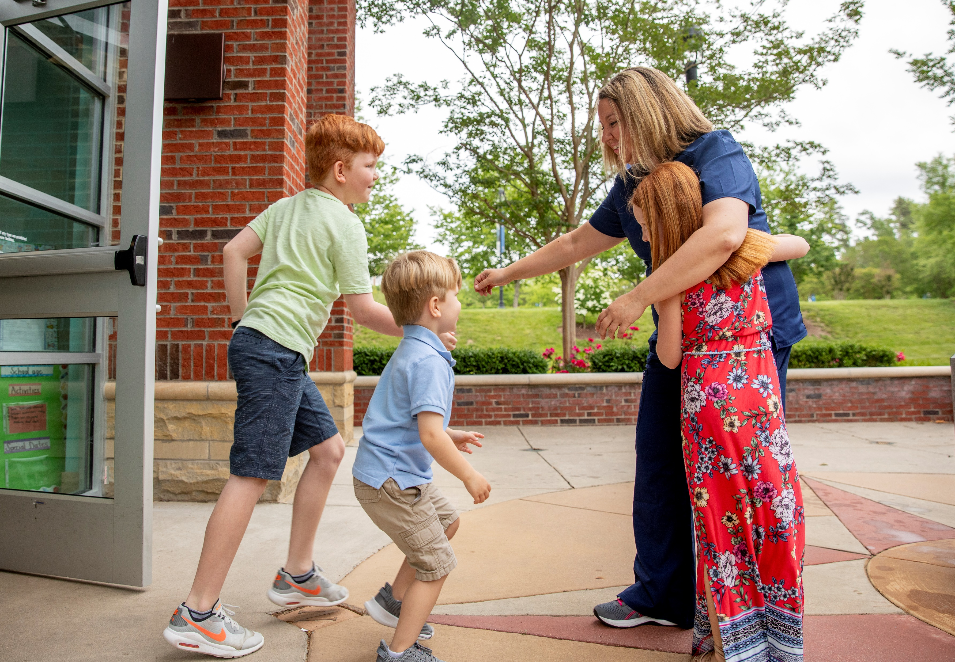
Mercy Health Foundation Greater Cincinnati
Notes:
These presentation notes have been designed to be read verbatim by the leader
I want to share some information about the upcoming Bon Secours Mercy Health Associate Campaign
My goal is to make sure that everyone understands what the Give for Good campaign is and how we all participate to strengthen our ministry’s care for our patients, associates and communities.

Slide 2
WHAT IS GIVE FOR GOOD?
OUR ANNUAL ASSOCIATE GIVING CAMPAIGN
The Campaign is an opportunity for Associates to support the mission of Bon Secours Mercy Health through a variety of gift options that benefit our patients, associates, and the local communities we serve.
Notes:
What is the Give for Good Associate Giving Campaign?
The Campaign is an opportunity for our associates to support our mission through a variety of gift options. Your contribution can be directed to our community and to a number of programs and special projects.
This year’s campaign kicks off on September 1st, and will continue through the entire month of September. Because of the pandemic and limits on some of the traditional in-person activities, you’ll be receiving campaign information to your home, by email and in Weekly Update e-newsletter.

Slide 3
WHY IS GIVE FOR GOOD SO IMPORTANT THIS YEAR?
WHEN WE GIVE, WE IMPACT THOSE WHO NEED HELP
OUR PATIENTS
OUR ASSOCIATES
OUR COMMUNITIES
Notes:
Why is this year's campaign so important?
As we all know too well, the pandemic has changed the way the world looks and operates.
The pandemic has brought to light many needs in our hospital and health system: clinical, technological, personal – even our own associates needing help.
Because of past and current support of associates and community donors, the Bon Secours Mercy Health Foundation provided funding for the Associate Hardship Fund during the pandemic. This fund helped low-census employees make up for lost wages, provided front-line employees with child-care and elder-care needs, and helped furloughed associates supplement unemployment benefits to make them financially whole.
This fund was critical in our time of need, but associates will continue to have crisis situations and need help even beyond COVID-19. The Associate Hardship Fund has been renamed the Caring for Our Own Fund and contributions are needed to help replenish it so our co-workers in a crisis can get help when they need it.

Slide 4
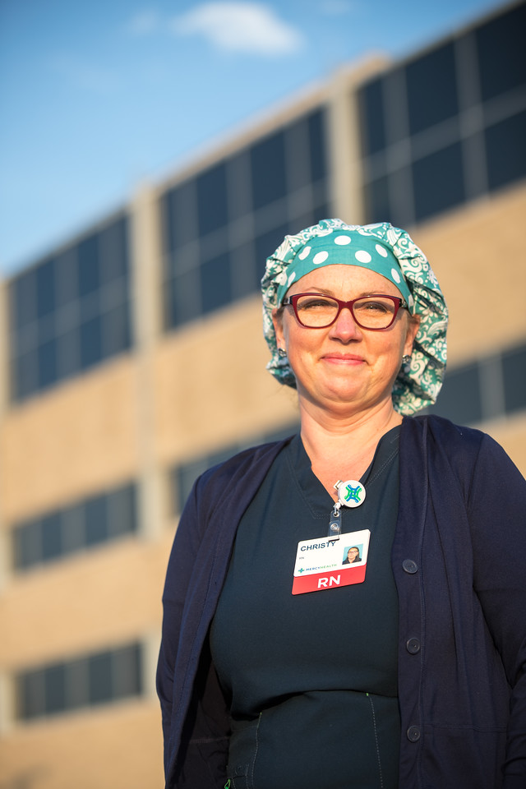
MEET CHRISTY
Thanks to donors like you, the Associate Hardship Fund (now called Caring for Our Own Fund) helped Christy have a place to rest when she had to work long hours during COVID-19.
Notes:
Meet Christy Wackerly
Christy is an emergency department nurse at Mercy Health – Fairfield Hospital, and she knew that her patients would need her more than ever during the pandemic. With small children at home, Christy worried about exposing her family to the virus after she was done working her long hours.
Because of donations to the Foundation, the Associate Hardship Fund was able to allow Christy and other front line workers to go straight from their shifts to nearby hotel rooms so they could take a break and clean up before going home to their families.
Christy could work with the peace of mind knowing that she would get a chance to rest, clean up, and re-group before going home to be with her family.

Slide 5
HOW CAN YOU HELP?
MAKE A GIVE FOR GOOD DONATION
THAT FITS YOUR PERSONAL CIRCUMSTANCES
POWER HOUR : 1 hour of pay per pay period
HALF HOUR HERO : ½ hour of pay per pay period
LEAD FOR GOOD: $1,000 gift
Notes:
How can we help?
We know it has been a challenging time for many associates, and each person’s financial circumstances are unique. Some people need some help. Some people are in a place where they can help others. What I ask is that you please consider a gift that is comfortable and meaningful to you, if you are able.
The choice of where you direct your support is personal – you can pick a program near and dear to you, or choose to direct your gift to the Greatest Need.
Some of us can give or renew at one of the Giving Levels on the screen: Power Hour, Half Hour Hero, and Lead for Good. Others may only be able to give a few dollars per pay period or a one-time gift.
When we all give what we can, it adds up to a lot of Good. And the needs of our patients and associates are greater than ever this year.

Slide 6
GIVE FOR GOOD.
THAT'S THE POWER OF US.
Together, we can make good happen right where we live and work.
BSMHgiveforgood.com
Notes:
Action Items
More than 10,000 Bon Secours Mercy Health Associates support the Foundation's giving campaign each year. Many programs and services that help our patients and associates depend on our donations.
You will receive a letter and brochure with giving options for our market at home in late August. Please read through the brochure and consider a gift to programs that mean the most to you.
The fastest and easiest way to give is online at BSMHgiveforgood.com. You can give by payroll deduction, donate unused PTO, give by credit card or bank draft.
If you have specific questions about the campaign, you can call email give@bsmhealth.org

