Slide 1
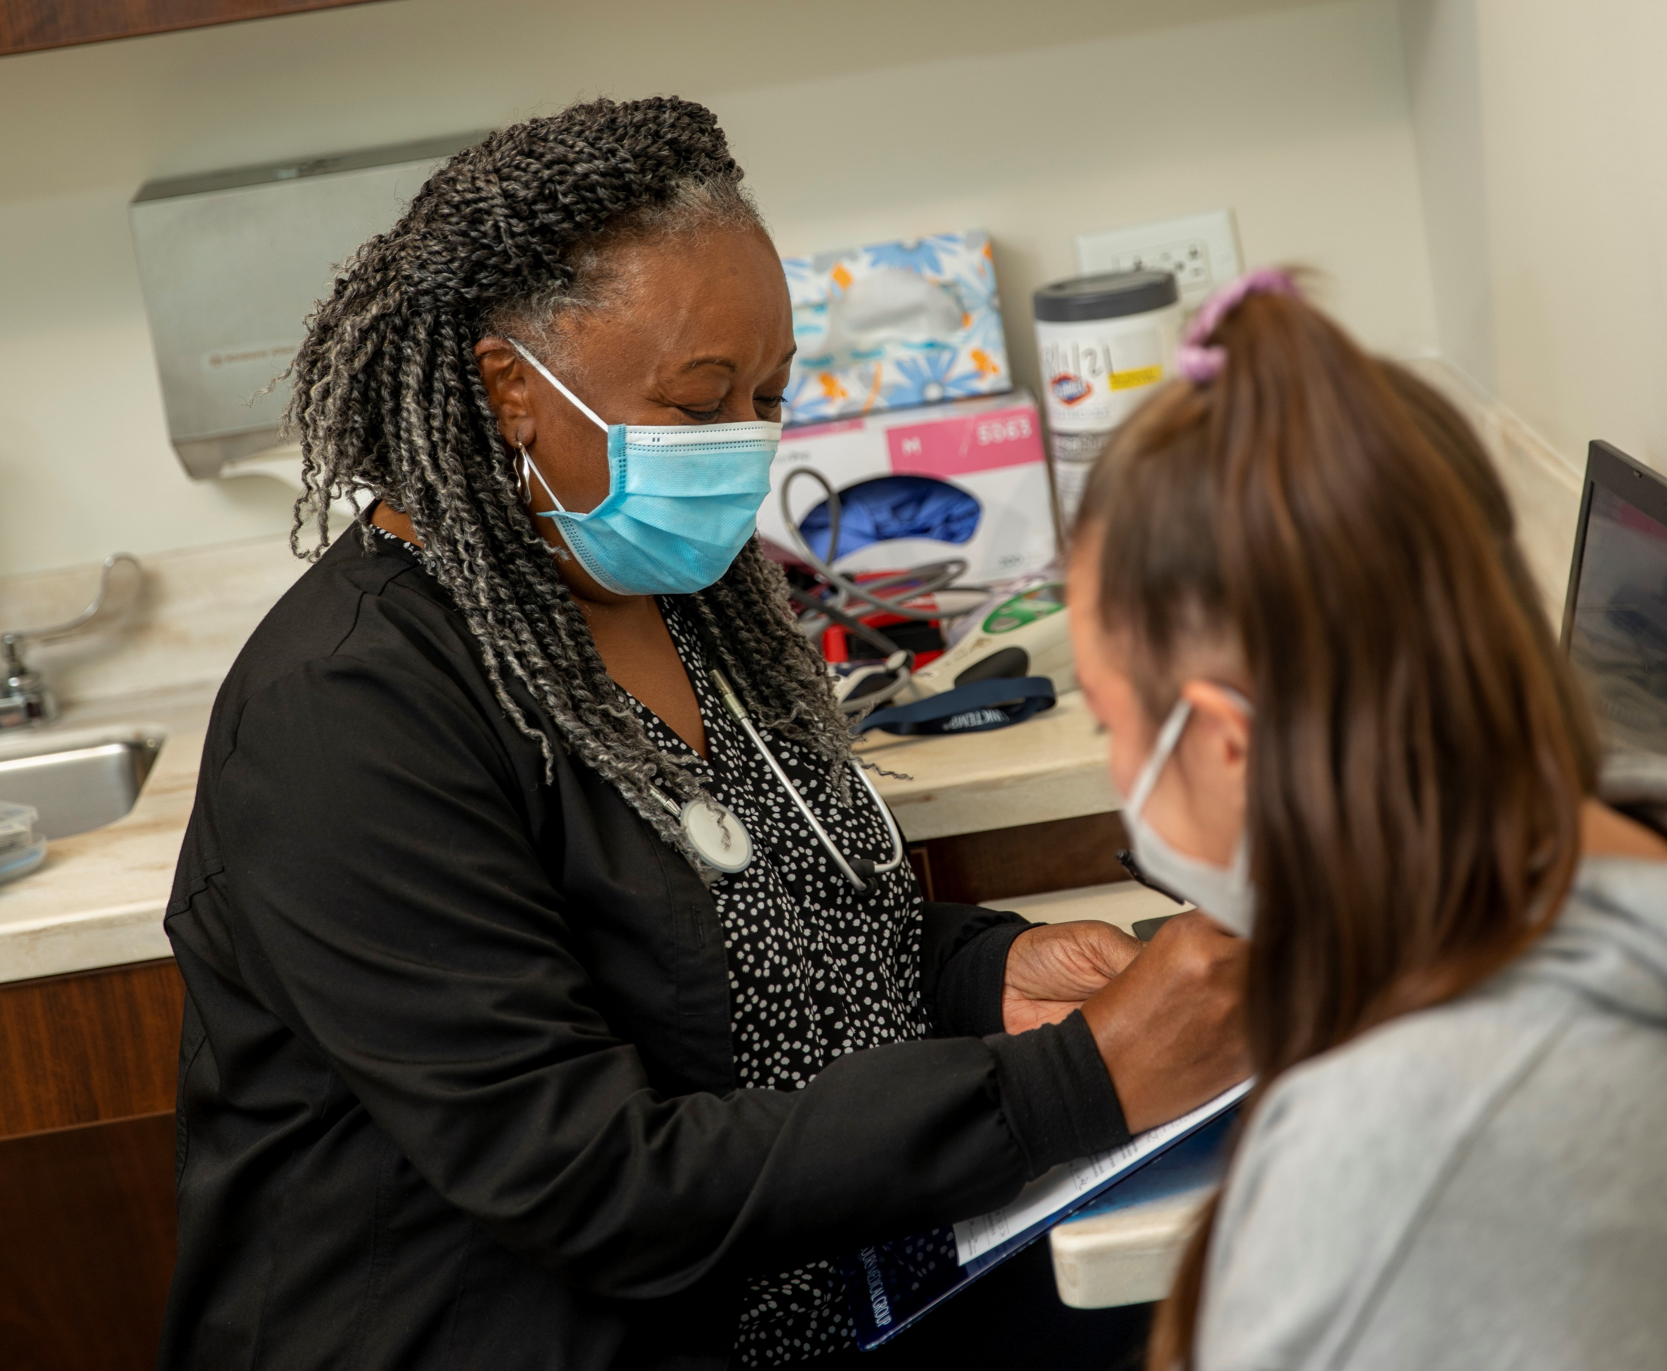
Mercy Health Foundation Greater Toledo
Notes:
These presentation notes have been designed to be read verbatim by the leader
I want to share some information about the upcoming Bon Secours Mercy Health Associate Campaign
My goal is to make sure that everyone understands what the Give for Good campaign is and how we all participate to strengthen our ministry’s care for our patients, associates and communities.

Slide 2
WHAT IS GIVE FOR GOOD?
OUR ANNUAL ASSOCIATE GIVING CAMPAIGN
The Campaign is an opportunity for Associates to support the mission of Bon Secours Mercy Health through a variety of gift options that benefit our patients, associates, and the local communities we serve.
Notes:
What is the Give for Good Associate Giving Campaign?
The Campaign is an opportunity for our associates to support our mission through a variety of gift options. Your contribution can be directed to our community and to several programs and special projects.
This year’s campaign kicks off on September 1st with an inaugural day of giving called, The Big Give. The Campaign will continue through the entire month of September. You’ll be receiving campaign information at your home, by email and in Weekly Update e-newsletter. We are also hoping to be able to hold more in-person activities this year.

Slide 3
WHY IS GIVE FOR GOOD SO IMPORTANT THIS YEAR?
WHEN WE GIVE, WE IMPACT THOSE WHO NEED HELP
OUR PATIENTS
OUR ASSOCIATES
OUR COMMUNITIES
Notes:
Why is this year's campaign so important?
As we emerge from the pandemic and adjust to a new normal, your support of the Give For Good Associate Campaign is more important than ever.
Gifts to the Associate Campaign remain local to help with patient care and community outreach right where you work and live.
Or you can give to a ministry-wide fund, like the Caring for Our Own Fund, which helps Associate across the ministry who are facing Hardships.

Slide 4
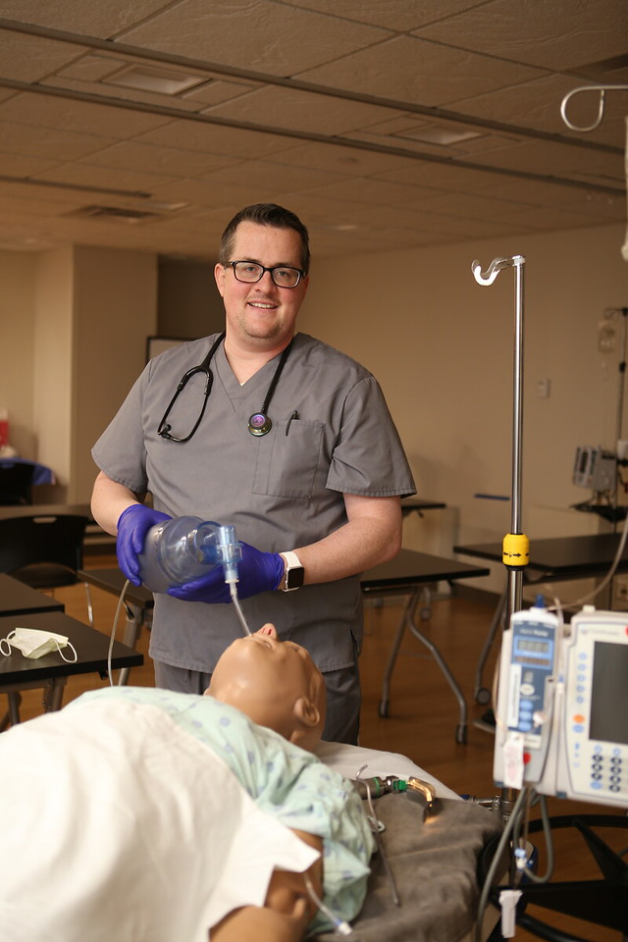
MEET TERRY
Terry Aragon thanks associate donors for supporting his continuing education.
Notes:
Most importantly, our gifts help people like Terry.
Third year medical student Terry Aragon remembers his first shift in an emergency room.
“I had to intubate a 65-year-old female who was in cardiac arrest,” he recalled.
Fortunately for Terry, the Graduate Medical Education simulation lab supported by associate donations was there for him, giving him a place to practice without the stress of live situations.
“I was able to ask as many questions as I wanted and it allowed me to really visualize the procedure, which helped me to successfully do it at the end of my rotation,” he said.
The aspiring pediatrician is also using the simulation lab to master his suturing skills.
“Being able to suture is huge especially in pediatric population because every kid cuts themselves at least once,” he said. “I’ve had experiences doing suturing over in the lab and that is going to help when I become a pediatrician.”
“I’m a hands-on learner and that’s why I like the sim lab, because I can get the practical experience I need,” he said.”
“Thank you for helping me learn better and for catering to my learning experience. It gives me the confidence to know I can go out and do it in the real world.”

Slide 5
HOW CAN YOU HELP?
MAKE A GIVE FOR GOOD DONATION
THAT FITS YOUR PERSONAL CIRCUMSTANCES
POWER HOUR : 1 hour of pay per pay period
HALF HOUR HERO : ½ hour of pay per pay period
LEAD FOR GOOD: $1,000 gift
Notes:
How can we help?
Each person’s financial circumstances are unique. What I ask is that you please consider a gift that is comfortable and meaningful to you.
The choice of where you direct your support is personal – you can pick a program near and dear to you or choose to direct your gift to the Greatest Need.
Some of us can give or renew at one of the Giving Levels on the screen: Power Hour, Half Hour Hero, and Lead for Good. Others may only be able to give a few dollars per pay period or a one-time gift.
When we all give what we can, it adds up to a lot of Good. And the needs of our patients and associates are greater than ever this year.

Slide 6
GIVING LEVEL REWARDS
Power Hour = 1 hour of pay per pay period
Lead for Good = $1,000 one-time gift or $38.47 per pay period
1,200 Called to Shine points
1,000 Called to Shine points
Half Hour Hero = One half hour of pay per pay period
600 Called to Shine points
Notes:
There are several special giving levels that you can choose, and you can even receive rewards.
Incentives
POWER HOUR is giving 1 hour of pay per pay period
1,200 Called to Shine points
LEAD FOR GOOD is a $1,000 gift either one time or spread over 26 pay periods
1,000 Called to Shine points
HALF HOUR HERO is giving ½ hour of pay per pay period
600 Called to Shine points
And as a bonus, if you make a gift of these levels during The Big Give, you will be eligible to receive a free t-shirt!

Slide 7
OTHER REWARDS
All donors with ongoing recurring gifts and new 2022 G4G recurring donors:
Will receive 100 bonus Called to Shine points
All donors will receive 75 Be Well points.
Notes:
Incentives
All donors with ongoing recurring gifts from campaigns past AND new donors who elect to have recurring gifts will get an additional 100 Called to Shine points
ALL DONORS will receive 75 be well points

Slide 8
The Big Give will take place on September 1st and will launch this year’s Give for Good Campaign.
It is an opportunity for Associates to make their gift in the first 24 hours of the Campaign and engage in unique activities planned at their hospital facilities.
In addition, all associates can look for emails throughout the day promoting The Big Give, special challenges, and giving rewards.
In addition to Campaign incentives, there will be fun giveaway items and a free shirt to claim when associates make an eligible gift during The Big Give.
Make your gift on September 1!
Notes:
What is The Big Give?
The Big Give will take place on September 1st to launch this year’s campaign. It is an opportunity for associates to make their gift in the first 24 hours of the Campaign and engage in unique activities planned at the facilities. Volunteer committees at each hospital facility have been working with Foundation staff representatives to plan a fun day! Donors can choose where to direct their support!
All Associates can look for emails throughout the day promoting The Big Give, special challenges, and giving rewards
There will be fun giveaway items and a free shirt to claim if you make an eligible gift at the Power Hour, Half Hour Hero, or Lead for Good level. Donors will also receive campaign incentives such as Called to Shine points when they make a recurring gift and all donors receive 75 Be Well Points.
We encourage all associates to make your gift on September 1 to make The Big Give a great success!

Slide 9
GIVE FOR GOOD.
THAT'S THE POWER OF US.
Together, we can make good happen right where we live and work.
BSMHgiveforgood.com
Notes:
Action Items
Thousands of Bon Secours Mercy Health Associates support the Foundation's giving campaign each year. Many programs and services that help our patients and associates depend on your donations.
You will receive a letter and brochure with giving options for our market at home in August. Please read through the brochure and consider a gift to programs that mean the most to you.
The fastest and easiest way to give is online at BSMHgiveforgood.com. You can give by payroll deduction, give by credit card or bank draft. Non-exempt (hourly) associates can even donate PTO.
If you have specific questions about the campaign, you can call email give@bsmhealth.org

