Slide 1
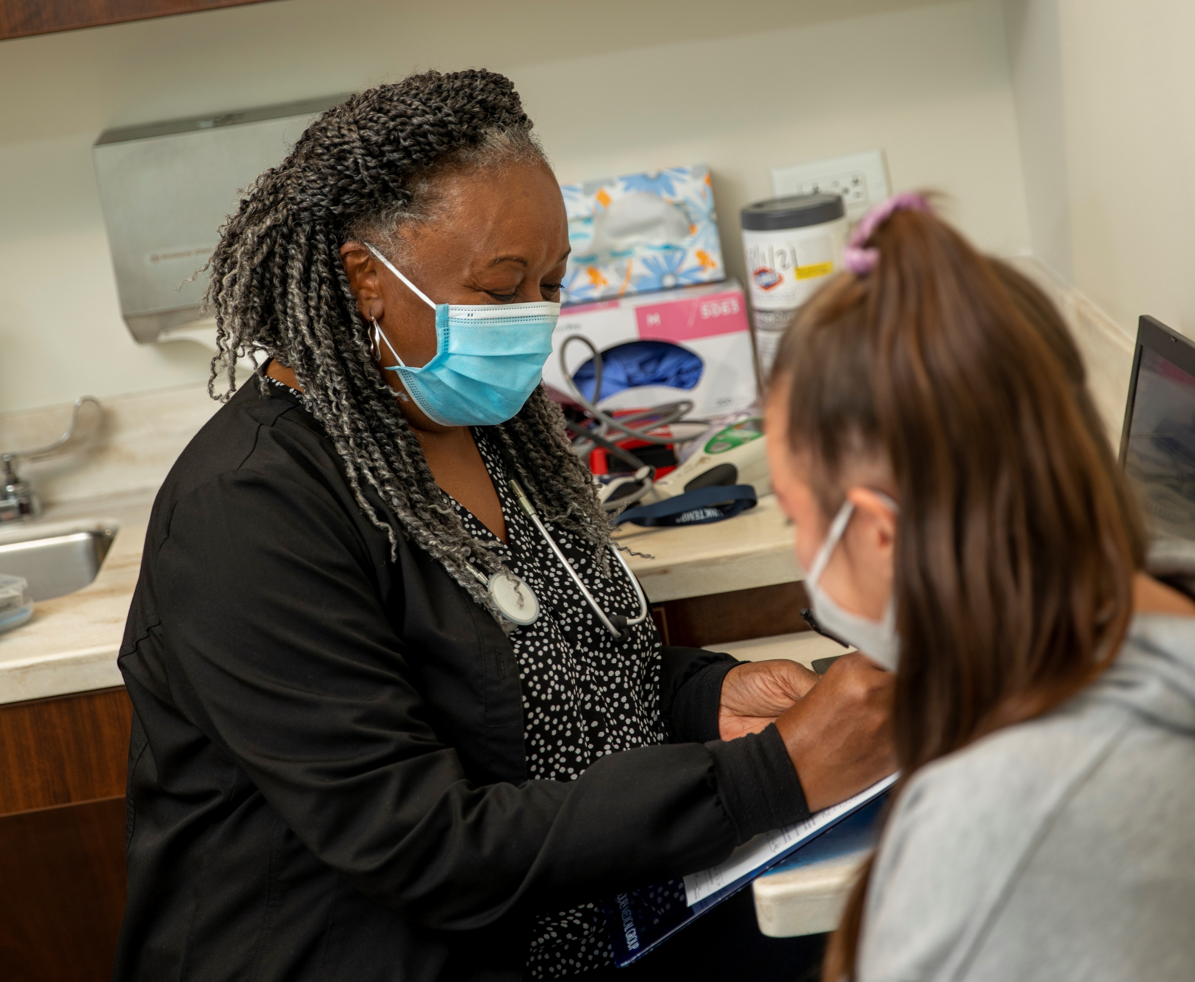
Bon Secours ​
Baltimore Foundation​
Notes:
These presentation notes have been designed to be read verbatim by the leader
Today we will be reviewing the upcoming Bon Secours Mercy Health Associate Campaign!

Slide 2
WHAT IS GIVE FOR GOOD?
OUR ANNUAL ASSOCIATE GIVING CAMPAIGN
The Campaign is an opportunity for Associates to support the mission of Bon Secours Mercy Health through a variety of gift options that benefit our patients, associates, and the local communities we serve.
Notes:
What is the Give for Good Associate Giving Campaign?
The Campaign is an opportunity for our associates to support our mission through a variety of gift options. Gifts can be directed to your community and to several programs and special projects.
This year’s campaign kicks off on August 30th with our day of giving celebration, THE BIG GIVE.
The Campaign will continue through the entire month of September. You will be receiving campaign information through mail, by email, and the Weekly Pulse.

Slide 3
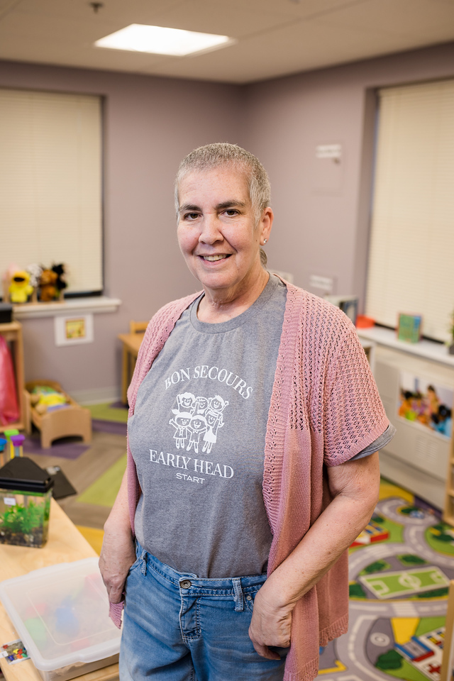
MEET AMY
Amy sees the impact of associate giving every day through Early Head Start
Notes:
Donations from associates to Bon Secours Baltimore Foundation help Amy Yost provide services to children and families that allow both to thrive.
As the Family Services Manager for Early Head Start, Amy is guided by two fundamental truths. The first is that children exposed to Early Head Start are better prepared for kindergarten than kids who aren't. The second is that supporting children doesn’t start or end with the children themselves.
“Everything that you do for a parent also benefits their child,” she says.
Amy connects parents with resources available through Bon Secours Community Works that help them achieve a stable and healthy environment for their children at home.
“We are here five days a week, which allows parents to work full time. That has a huge impact on families,” Amy says.
Donors support Amy’s family advocacy efforts at Early Head Start in a variety of ways by providing critical funding and supplementing specific needs.
“For example, at Christmas, we did a toy drive and fell short of what we needed. The Foundation stepped in to provide extra gifts for our families so everyone had enough,” she says.
As a Bon Secours associate, Amy also supports the Foundation herself.
“I believe in the Foundation’s mission of supporting people in need,” she says. “And the support given to our efforts is very needed and very appreciated.”

Slide 4
WHAT is THE BIG GIVE?
The 24-hour fundraising event to kick-off the Give for Good Campaign.
HOW can I celebrate THE BIG GIVE?
As the volunteer committee, we will work together to plan fun events at your facilities!
WHY should I participate?
Every contribution adds up and can make a difference for those we serve. You can become eligible for rewards and counted in THE BIG GIVE efforts if you give NOW until 8/30/23
Current recurring gift donors will be counted and eligible for incentives.
Notes:
This year, THE BIG GIVE will take place on August 30th and will launch this year’s campaign.
This is a call to action for everyone to make their gift in the first 24 hours of the Give for Good campaign, and engage in activities in celebration of the kick-off of Give for Good.
There will be fun giveaway items and specific THE BIG GIVE incentives for associates who give at the Power Hour, Half Hour Hero, and Lead for Good levels.
Make sure to make your gift before midnight on 8/30!
Donors who have recurring gifts do not need to renew and will be eligible for THE BIG GIVE incentives.

Slide 5
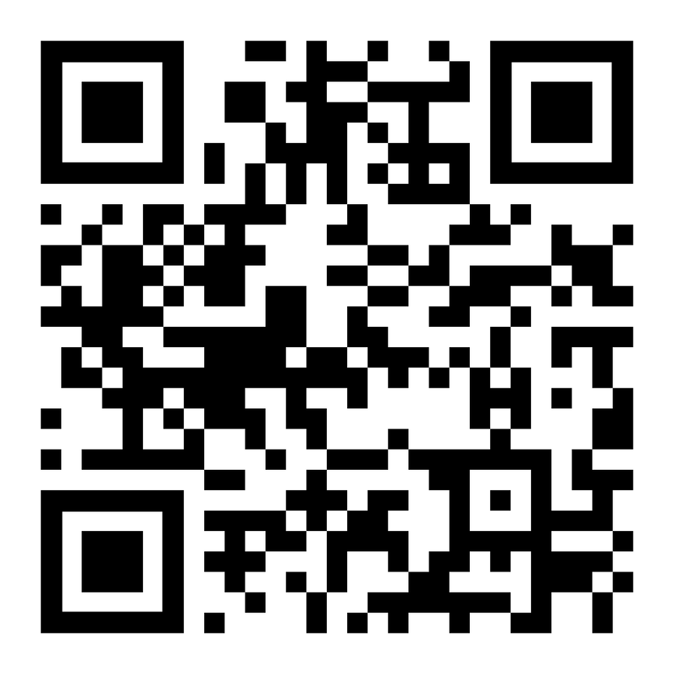
WAYS TO GIVE
Per Pay Period Deductions
Power Hour
Lead for Good
Half Hour Hero
Other chosen amount
One-time gifts: cash, credit card, payroll deduction
PTO
Hourly associates
Visit bsmhgiveforgood.com or scan the QR Code to make your gift today!
Notes:
There are many different ways you can choose to make a gift.
Per pay period deductions that will take place the first pay period of 2024. You can choose to do a per pay period deduction at the Power Hour level, one hour of pay per pay period, Lead for Good, a $1,000 pledge for the year that can be deducted evenly throughout the year or in one deduction, Half Hour Hero, a gift of a half hour of pay per pay period, or at any amount you prefer.
There is also an opportunity to do a one time payroll deduction that will take place in November. One time gifts made by cash and credit card are also accepted.
Hourly associates are able to donate unused PTO (only hourly due to HR policy, if asked.)
Gifts can be made by simply filling out a form online at bsmhgiveforgood.com or returning the brochure received at each associate's home.

Slide 6
INCENTIVES
Power Hour = 1 hour of pay per pay period
Lead for Good = $1,000 one-time gift or $38.47 per pay period
1,200 Called to Shine points
1,000 Called to Shine points
Half Hour Hero = One half hour of pay per pay period
600 Called to Shine points
Notes:
If you give at the Power Hour, Lead for Good, or Half Hour Hero level, you can be eligible for the following rewards:
POWER HOUR 1 hour of pay per pay period
1,200 Called to Shine points
LEAD FOR GOOD $1,000 gift either one time or spread over 26 pay periods
1,000 Called to Shine points
HALF HOUR HERO ½ hour of pay per pay period
600 Called to Shine points
As a bonus, if a gift at these levels is made before midnight August 30th during THE BIG GIVE, donors can be eligible for a free shirt.

Slide 7
INCENTIVES
Donors who make a first-time recurring gift before midnight 8/30/23 will receive 500 Called to Shine Points
All other recurring gifts will receive 100 Called to Shine Points
All donors will receive 75 Be Well points.
Notes:
In addition to the giving level incentives:
Donors who make a first-time recurring gift before midnight 8/30/23 will receive 500 Called to Shine Points
All other recurring gifts will receive 100 Called to Shine Points
ALL DONORS will receive 75 be well points

Slide 8
KEY CONTACT INFORMATION
Rachel Wallace: BSMH Foundation Event Coordinator
rachel_wallace@bshsi.org
(804) 339-6368
Clare Gordon: Senior Employee Giving Specialist
csgordon@mercy.com
(513) 869 -5130
Notes:
In the case that anyone has any questions about their past giving, or any questions regarding the campaign, please reach out to these individuals.

Slide 9
Together we can make an impact right where we live & work!
BSMHgiveforgood.com
Notes:
Thousands of Bon Secours Mercy Health Associates support the Foundation's giving campaign each year. Many programs and services that help our patients and associates depend on your donations.
You will receive a letter and brochure with giving options for our market at home in August. Please read through the brochure and consider a gift to programs that mean the most to you.
The fastest and easiest way to give is online at BSMHgiveforgood.com.
Thank you!

