Slide 1
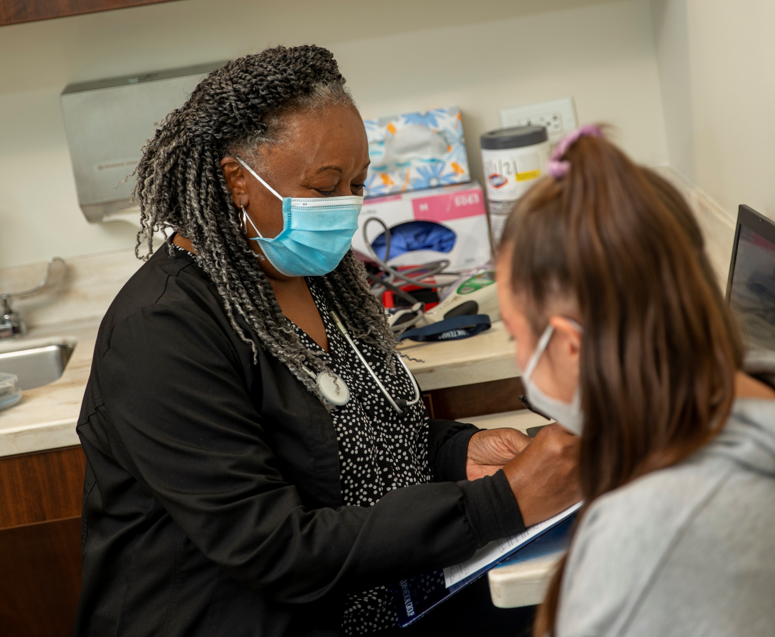
Mercy Health Foundation Mahoning Valley​​
Notes:
These presentation notes have been designed to be read verbatim by the leader
Today we will be reviewing the upcoming Bon Secours Mercy Health Associate Campaign!

Slide 2
WHAT IS GIVE FOR GOOD?
OUR ANNUAL ASSOCIATE GIVING CAMPAIGN
The Campaign is an opportunity for Associates to support the mission of Bon Secours Mercy Health through a variety of gift options that benefit our patients, associates, and the local communities we serve.
Notes:
What is the Give for Good Associate Giving Campaign?
The Campaign is an opportunity for our associates to support our mission through a variety of gift options. Gifts can be directed to your community and to several programs and special projects.
This year’s campaign kicks off on August 30th with our day of giving celebration, THE BIG GIVE.
The Campaign will continue through the entire month of September. You will be receiving campaign information through mail, by email, and the Weekly Pulse.

Slide 3
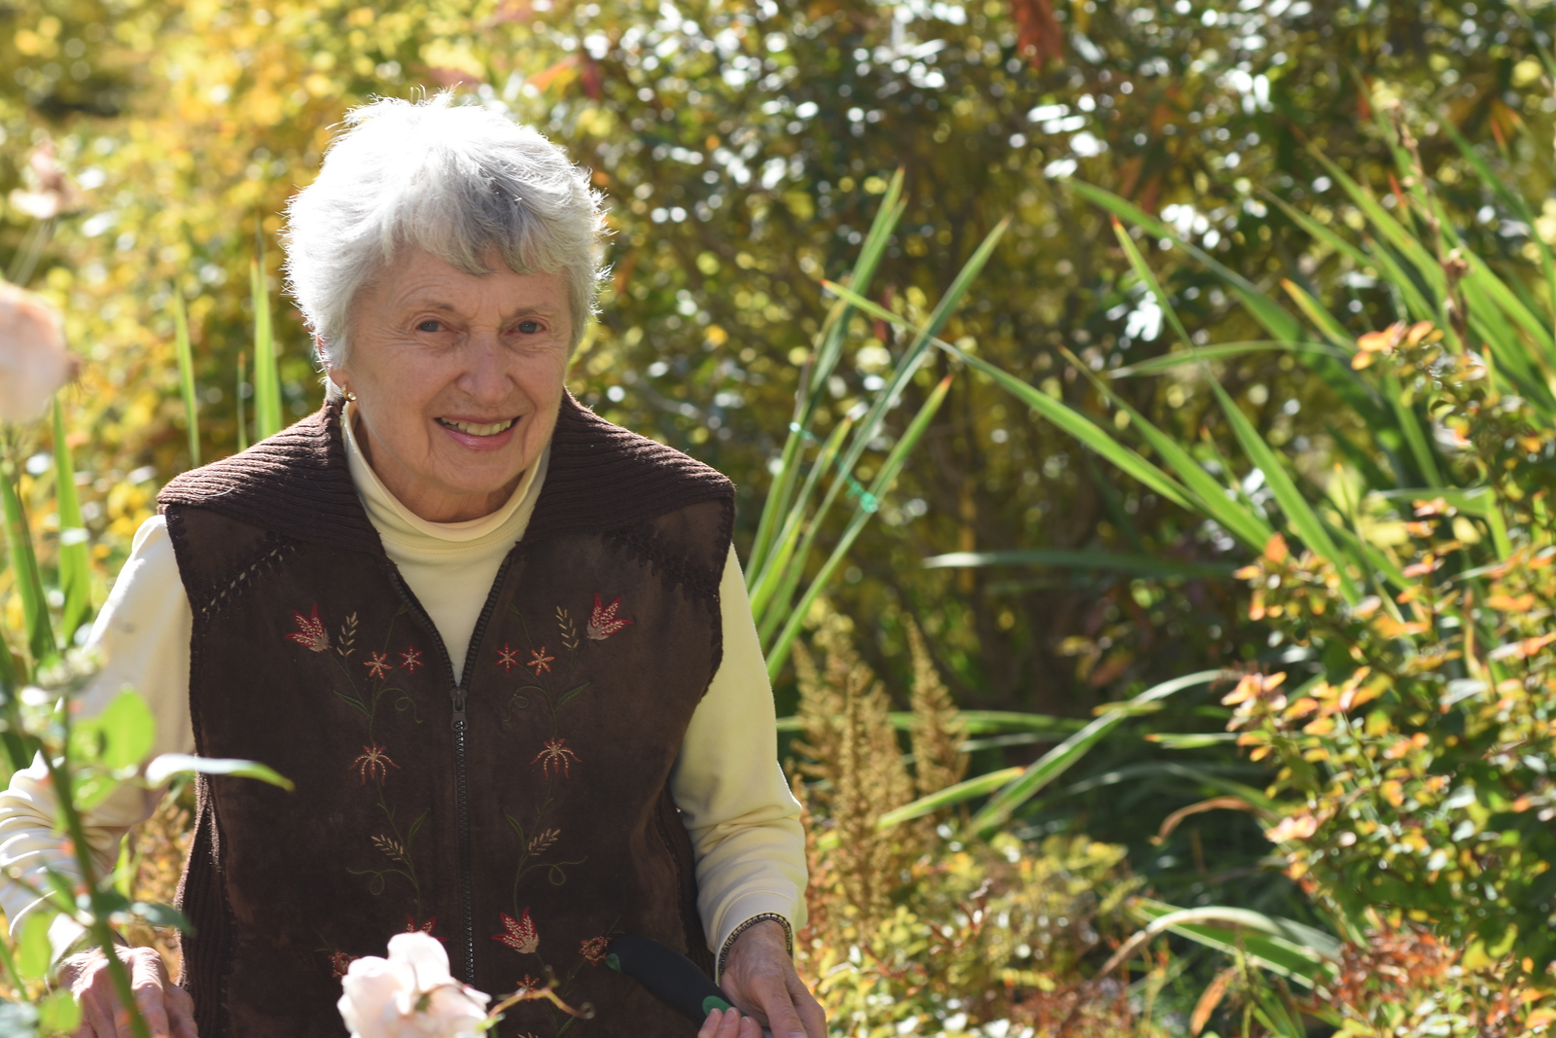
MEET SANDY
Sandy got to spend her last months with her beloved husband John in their home because of gifts for hospice.
Hospice of the Valley is one of the featured funds for this year's Campaign!
Notes:
Sandy McLachlan and her husband, John, spent more than 60 years together, and thanks to donors to Hospice of the Valley, they were together until the very end.
They met at a freshman mixer at Mount Union College and became instant friends. Eventually they married, had a family and built a life together.
“We were a team,” Sandy says.
During their Christmas gathering John developed a cough and felt ill enough to lie down for a nap. Sandy went to wake him after the guests left.
“Something had dramatically changed,” Sandy recalls. “He was very close to unresponsive.”
John was placed in hospice care the next day. While he regained some strength and his quality of life was good, John’s overall health continued to decline.
“Hospice made it possible for me to keep him at home,” says Sandy.
Donations for Hospice of the Valley provided nurses, aides and a case manager to help both John and Sandy with whatever they needed over the next 17 months. A volunteer even sat with John so Sandy could take a break and work in the garden.
“That helped my mental health tremendously,” she says.
“He died in my arms with me telling him how much I loved him and how glad I was that I married him. It was a blessing that I thank hospice for because they made it possible for me to do that.”
“It’s the people who donate to hospice that make it possible for the kind of support that I had,” Sandy says. “That’s a tremendous gift. Thank you.”

Slide 4
WHAT is THE BIG GIVE?
The 24-hour fundraising event to kick-off the Give for Good Campaign.
HOW can I celebrate THE BIG GIVE?
As the volunteer committee, we will work together to plan fun events at your facilities!
WHY should I participate?
Every contribution adds up and can make a difference for those we serve. You can become eligible for rewards and counted in THE BIG GIVE efforts if you give NOW until 8/30/23
Current recurring gift donors will be counted and eligible for incentives.
Notes:
This year, THE BIG GIVE will take place on August 30th and will launch this year’s campaign.
This is a call to action for everyone to make their gift in the first 24 hours of the Give for Good campaign, and engage in activities in celebration of the kick-off of Give for Good.
There will be fun giveaway items and specific THE BIG GIVE incentives for associates who give at the Power Hour, Half Hour Hero, and Lead for Good levels.
Make sure to make your gift before midnight on 8/30!
Donors who have recurring gifts do not need to renew and will be eligible for THE BIG GIVE incentives.

Slide 5
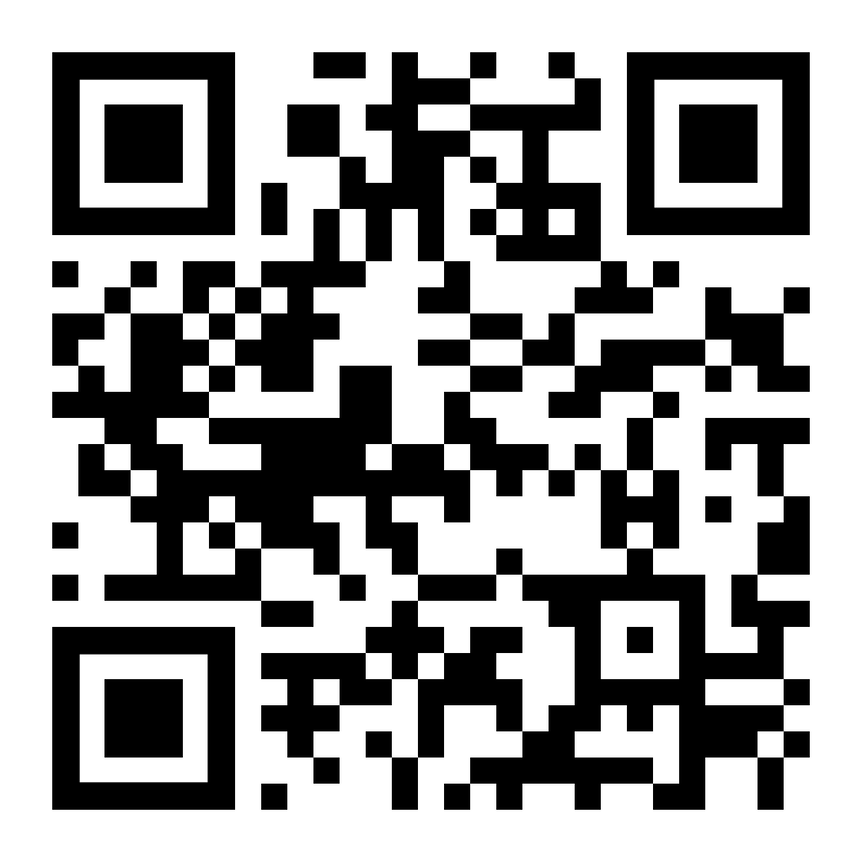
WAYS TO GIVE
Per Pay Period Deductions
Power Hour
Lead for Good
Half Hour Hero
Other chosen amount
One-time gifts: cash, credit card, payroll deduction
PTO
Hourly associates
Visit bsmhgiveforgood.com or scan the QR Code to make your gift today!
Notes:
There are many different ways you can choose to make a gift.
Per pay period deductions that will take place the first pay period of 2024. You can choose to do a per pay period deduction at the Power Hour level, one hour of pay per pay period, Lead for Good, a $1,000 pledge for the year that can be deducted evenly throughout the year or in one deduction, Half Hour Hero, a gift of a half hour of pay per pay period, or at any preferred amount.
There is also an opportunity to do a one time payroll deduction that will take place in November. One time gifts made by cash and credit card are also accepted.
Hourly associates are able to donate unused PTO (only hourly due to HR policy, if asked.)
Gifts can be made by simply filling out a form online at bsmhgiveforgood.com or returning the brochure received at each associate's home.

Slide 6
INCENTIVES
Power Hour = 1 hour of pay per pay period
Lead for Good = $1,000 one-time gift or $38.47 per pay period
1,200 Called to Shine points
1,000 Called to Shine points
Half Hour Hero = One half hour of pay per pay period
600 Called to Shine points
Notes:
If you give at the Power Hour, Lead for Good, or Half Hour Hero level, you can be eligible for the following rewards:
POWER HOUR 1 hour of pay per pay period
1,200 Called to Shine points
LEAD FOR GOOD $1,000 gift either one time or spread over 26 pay periods
1,000 Called to Shine points
HALF HOUR HERO ½ hour of pay per pay period
600 Called to Shine points
As a bonus, if a gift at these levels is made before midnight August 30th during THE BIG GIVE, donors can be eligible for a free shirt.

Slide 7
INCENTIVES
Donors who make a first-time recurring gift before midnight 8/30/23 will receive 500 Called to Shine Points
All other recurring gifts will receive 100 Called to Shine Points
All donors will receive 75 Be Well points.
Notes:
In addition to the giving level incentives:
Donors who make a first-time recurring gift before midnight 8/30/23 will receive 500 Called to Shine Points
All other recurring gifts will receive 100 Called to Shine Points
ALL DONORS will receive 75 be well points

Slide 8
KEY CONTACT INFORMATION
Jessica Jordan: BSMH Foundation Event Coordinator
jjordan@mercy.com
(419) 975-4305
Clare Gordon: Senior Employee Giving Specialist
csgordon@mercy.com
(513) 869 -5130
Notes:
In the case that anyone has any questions about their past giving, or any questions regarding the campaign, please reach out to these individuals.

Slide 9
Together we can make an impact right where we live & work!
BSMHgiveforgood.com
Notes:
Thousands of Bon Secours Mercy Health Associates support the Foundation's giving campaign each year. Many programs and services that help our patients and associates depend on your donations.
You will receive a letter and brochure with giving options for our market at home in August. Please read through the brochure and consider a gift to programs that mean the most to you.
The fastest and easiest way to give is online at BSMHgiveforgood.com.
Thank you!

